Slide 1
Read the Friendly PowerShell Logs
9th Dutch PowerShell User Group – November 2016

Slide 2
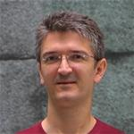



About_speakers
@alexandair
@bundyfx
@jaap_brasser

Slide 3




Agenda
Streams in PowerShell
Logs in PowerShell

Slide 4
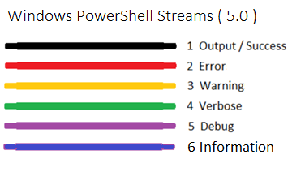
Streams in PowerShell

Slide 5
Different streams
Demo

Slide 6
Transcription
Transcribe to log files containing the following information
Timestamp
User
RunAs user
Machine
Application
Etc…

Slide 7
Event logs
Module logging
Scriptblock logging
Deep scriptblock logging

Slide 8
PowerShell Logs
Demo

Slide 9
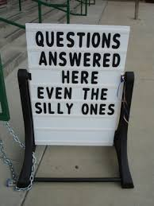
Questions?

